Slide 1
Data Description 18 Infographics Deck
Compiled presentation for study, teaching, and training
1. Module 1: Foundations of Data Description
• Data Description: Turning Raw Data into Meaningful Summary
• Statistic vs Parameter: Sample Measure vs Population Measure
• Measures of Central Tendency: Mean, Median, Mode, and Midrange
2. Module 2: Measures of Central Tendency
• Arithmetic Mean: Sample Mean and Population Mean
• Mean for Grouped Data: Using Frequency and Class Midpoints
• Weighted Mean: When All Values Are Not Equally Important
• Median: Finding the Middle of Ordered Data
• Mode: Finding the Most Frequent Value
• Midrange: Quick Center from Lowest and Highest Values
• Choosing the Best Measure of Central Tendency
3. Module 3: Shape of Data
• Distribution Shapes and the Location of Mean, Median, and Mode
• Skewness: Understanding Asymmetry in Data
• Kurtosis: Sharpness and Flatness of a Distribution
4. Module 4: Measures of Variation
• Measures of Variation: Why Spread Matters
• Range: The Simplest Measure of Spread
• Variance and Standard Deviation: Measuring Data Spread Around the Mean
• Coefficient of Variation: Comparing Relative Variability
5. Module 5: Boxplot, Z-Score, and Outliers
• Boxplot, Five-Number Summary, Z-Score, and Outliers
Overview of all 18 infographics

Slide 2
Module 1: Foundations of Data Description
3 infographic slides
Section 1 of 5

Slide 3
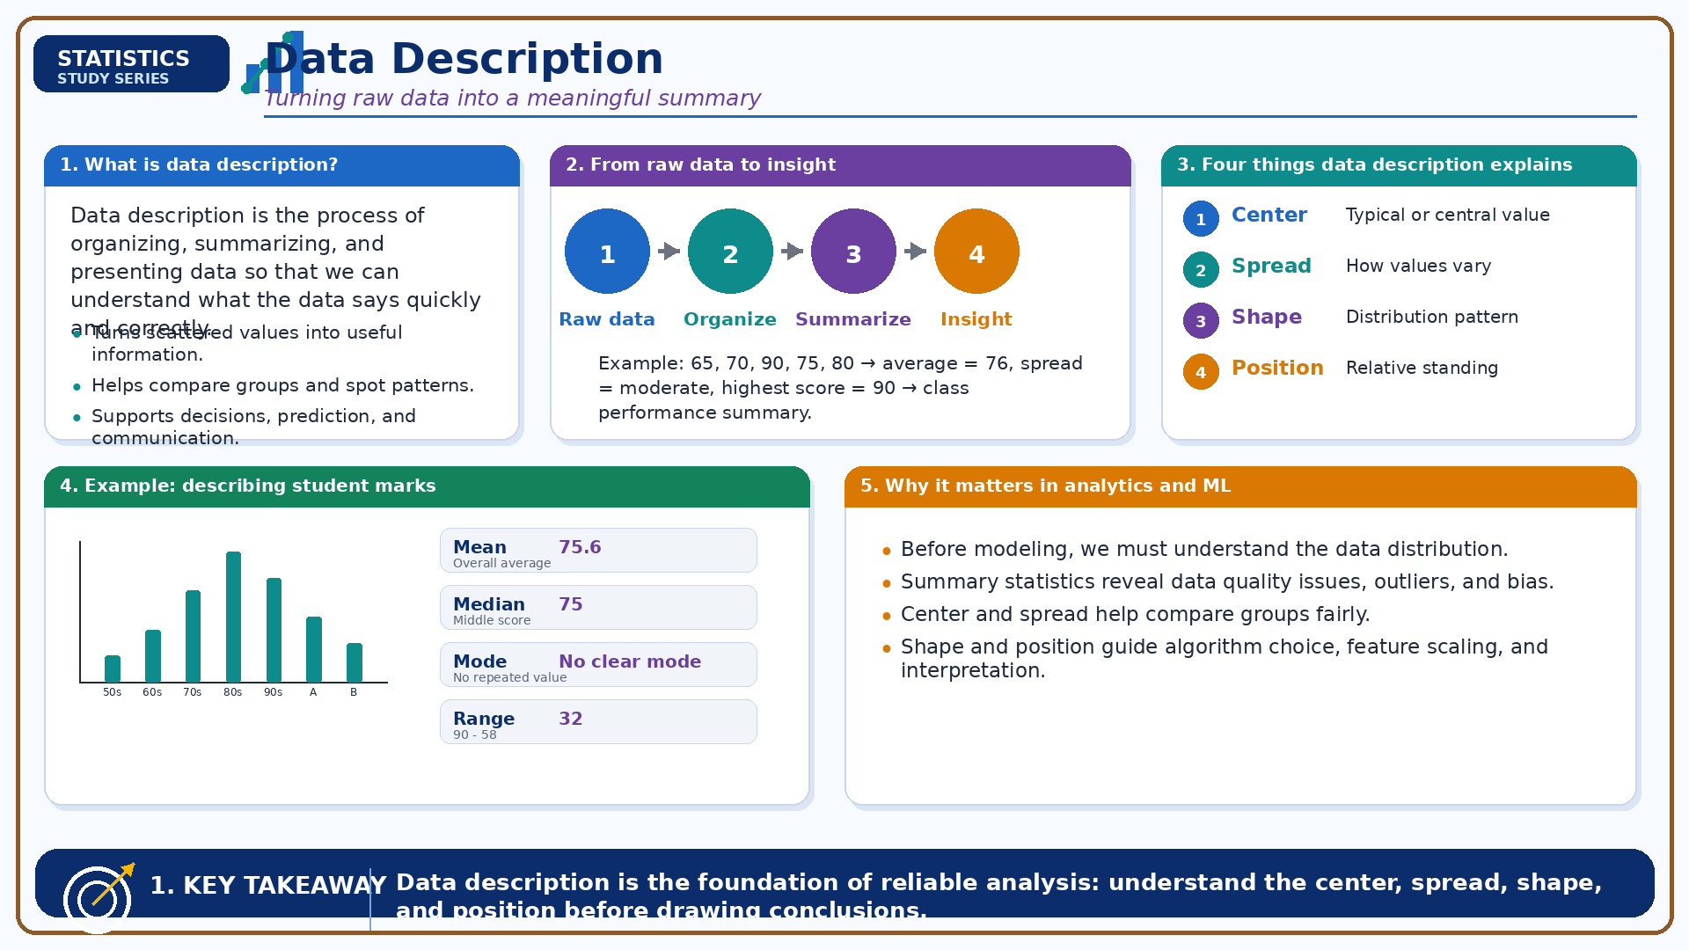
Data Description: Turning Raw Data into Meaningful Summary
Module 1: Foundations of Data Description
Infographic 1 of 18

Slide 4
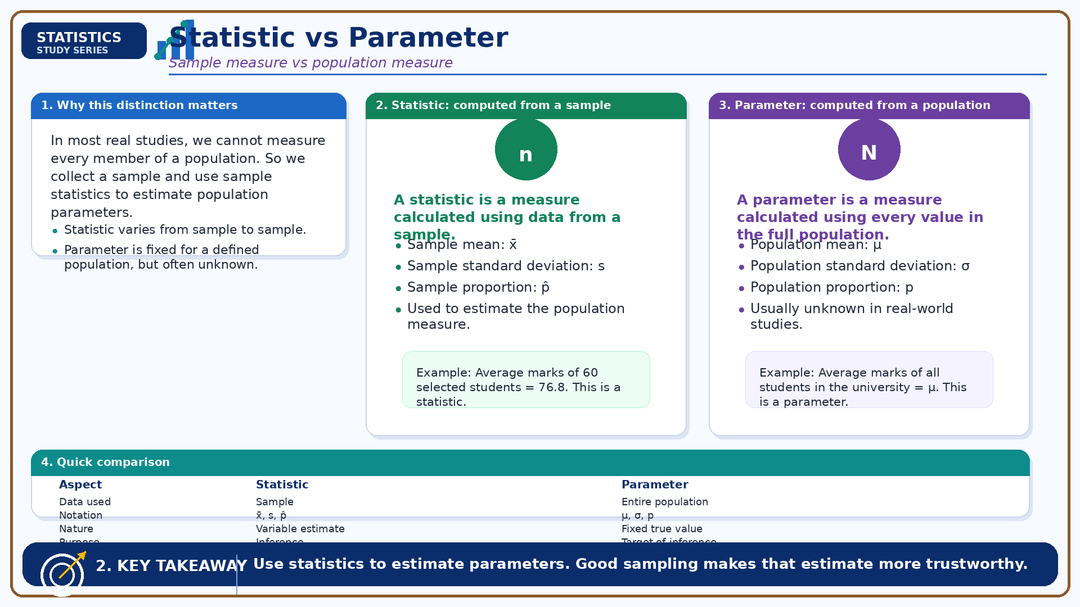
Statistic vs Parameter: Sample Measure vs Population Measure
Module 1: Foundations of Data Description
Infographic 2 of 18

Slide 5
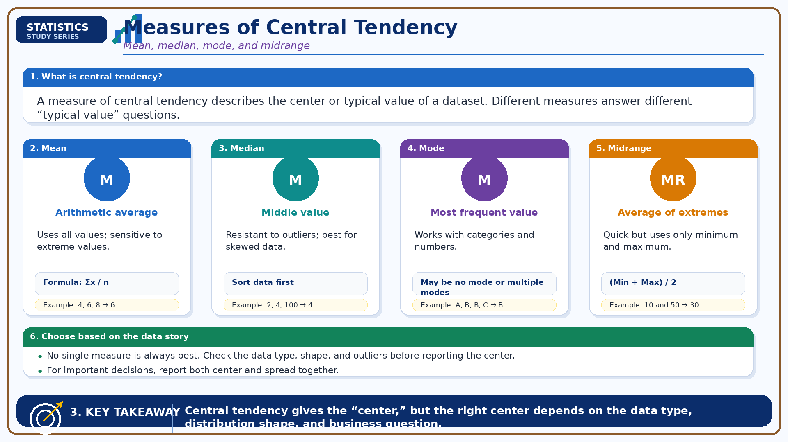
Measures of Central Tendency: Mean, Median, Mode, and Midrange
Module 1: Foundations of Data Description
Infographic 3 of 18

Slide 6
Module 2: Measures of Central Tendency
7 infographic slides
Section 2 of 5

Slide 7
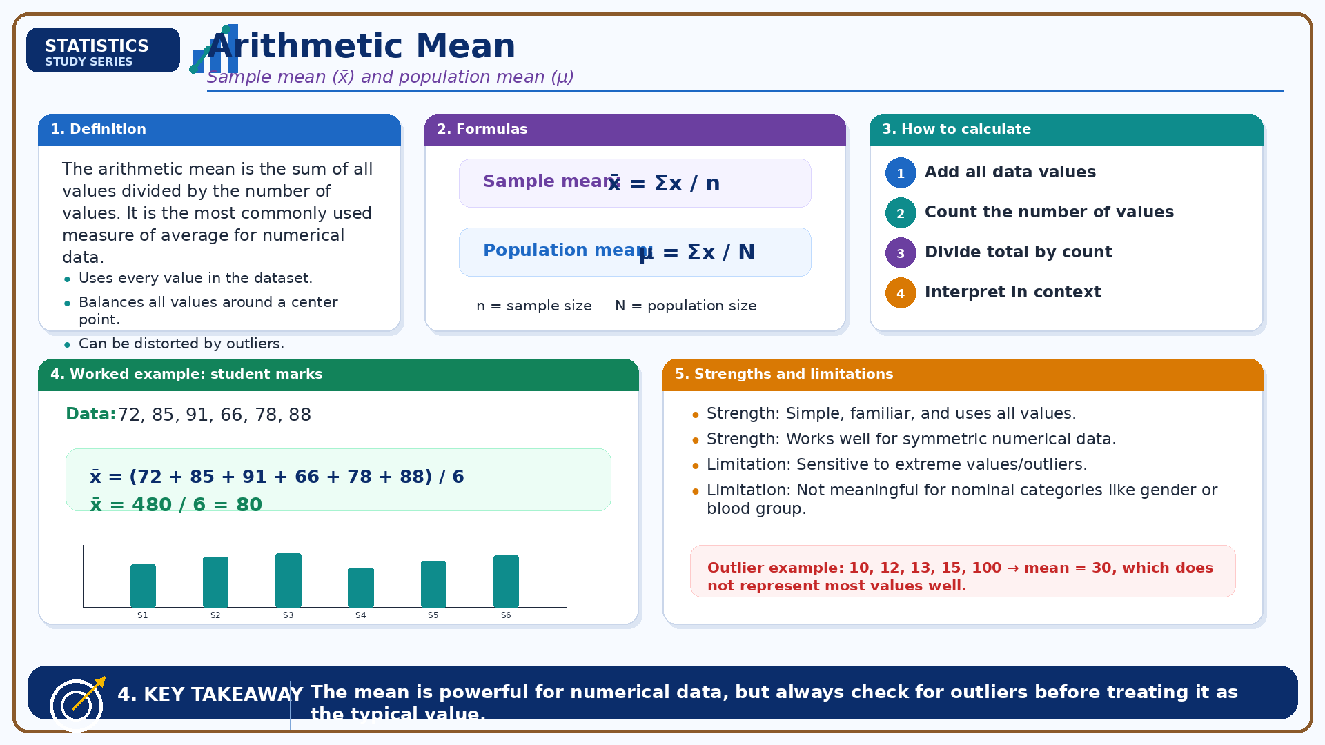
Arithmetic Mean: Sample Mean and Population Mean
Module 2: Measures of Central Tendency
Infographic 4 of 18

Slide 8
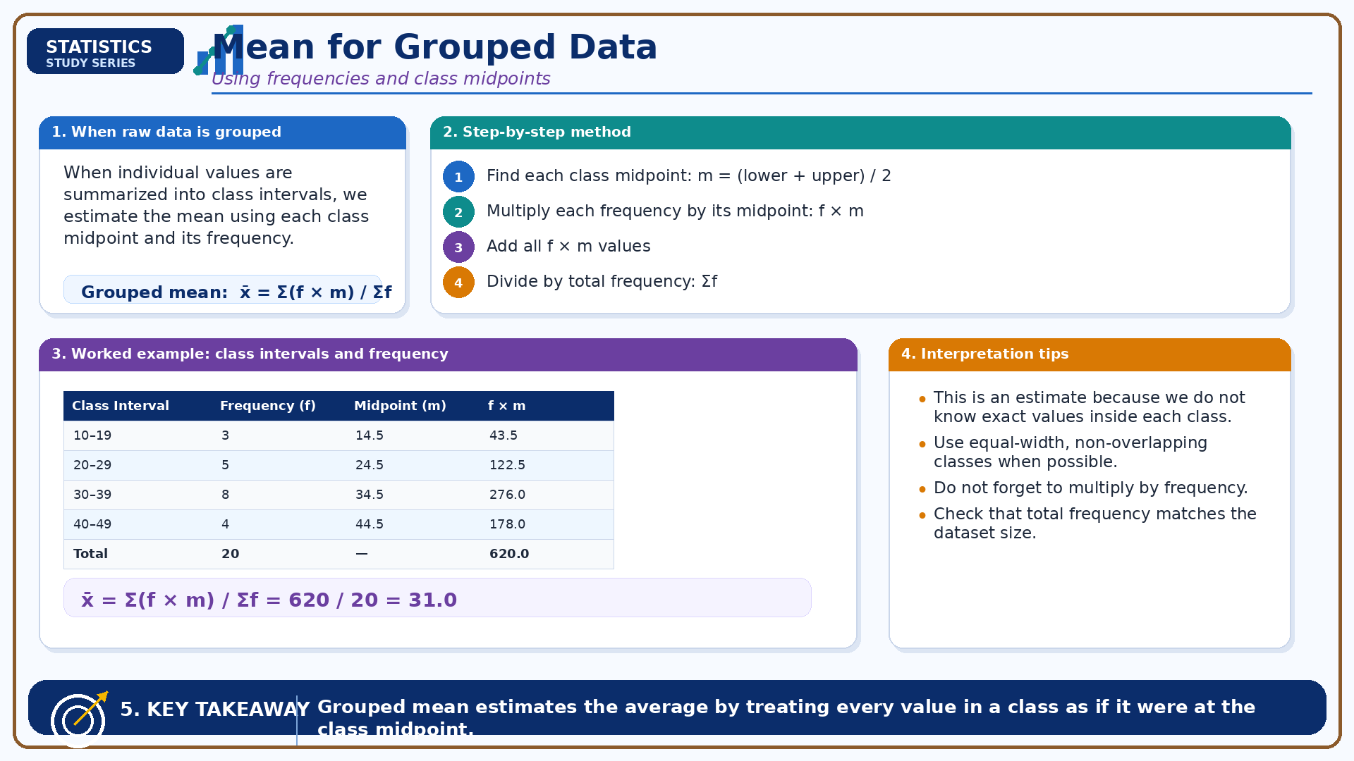
Mean for Grouped Data: Using Frequency and Class Midpoints
Module 2: Measures of Central Tendency
Infographic 5 of 18

Slide 9
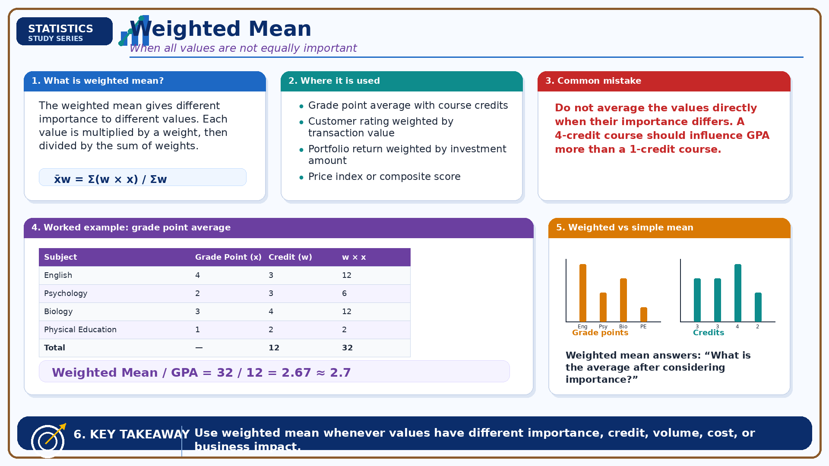
Weighted Mean: When All Values Are Not Equally Important
Module 2: Measures of Central Tendency
Infographic 6 of 18

Slide 10
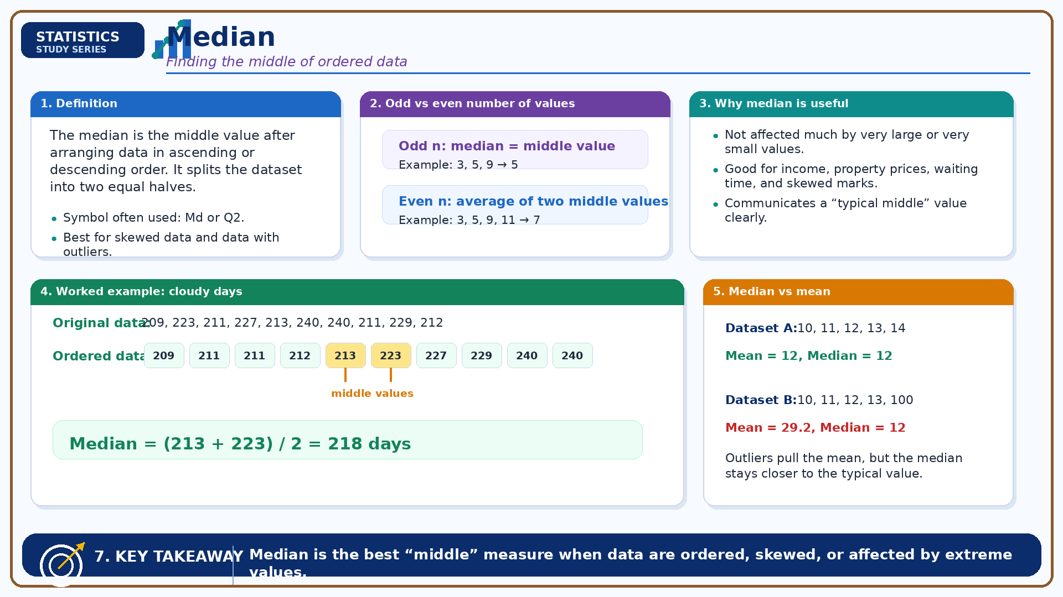
Median: Finding the Middle of Ordered Data
Module 2: Measures of Central Tendency
Infographic 7 of 18

Slide 11
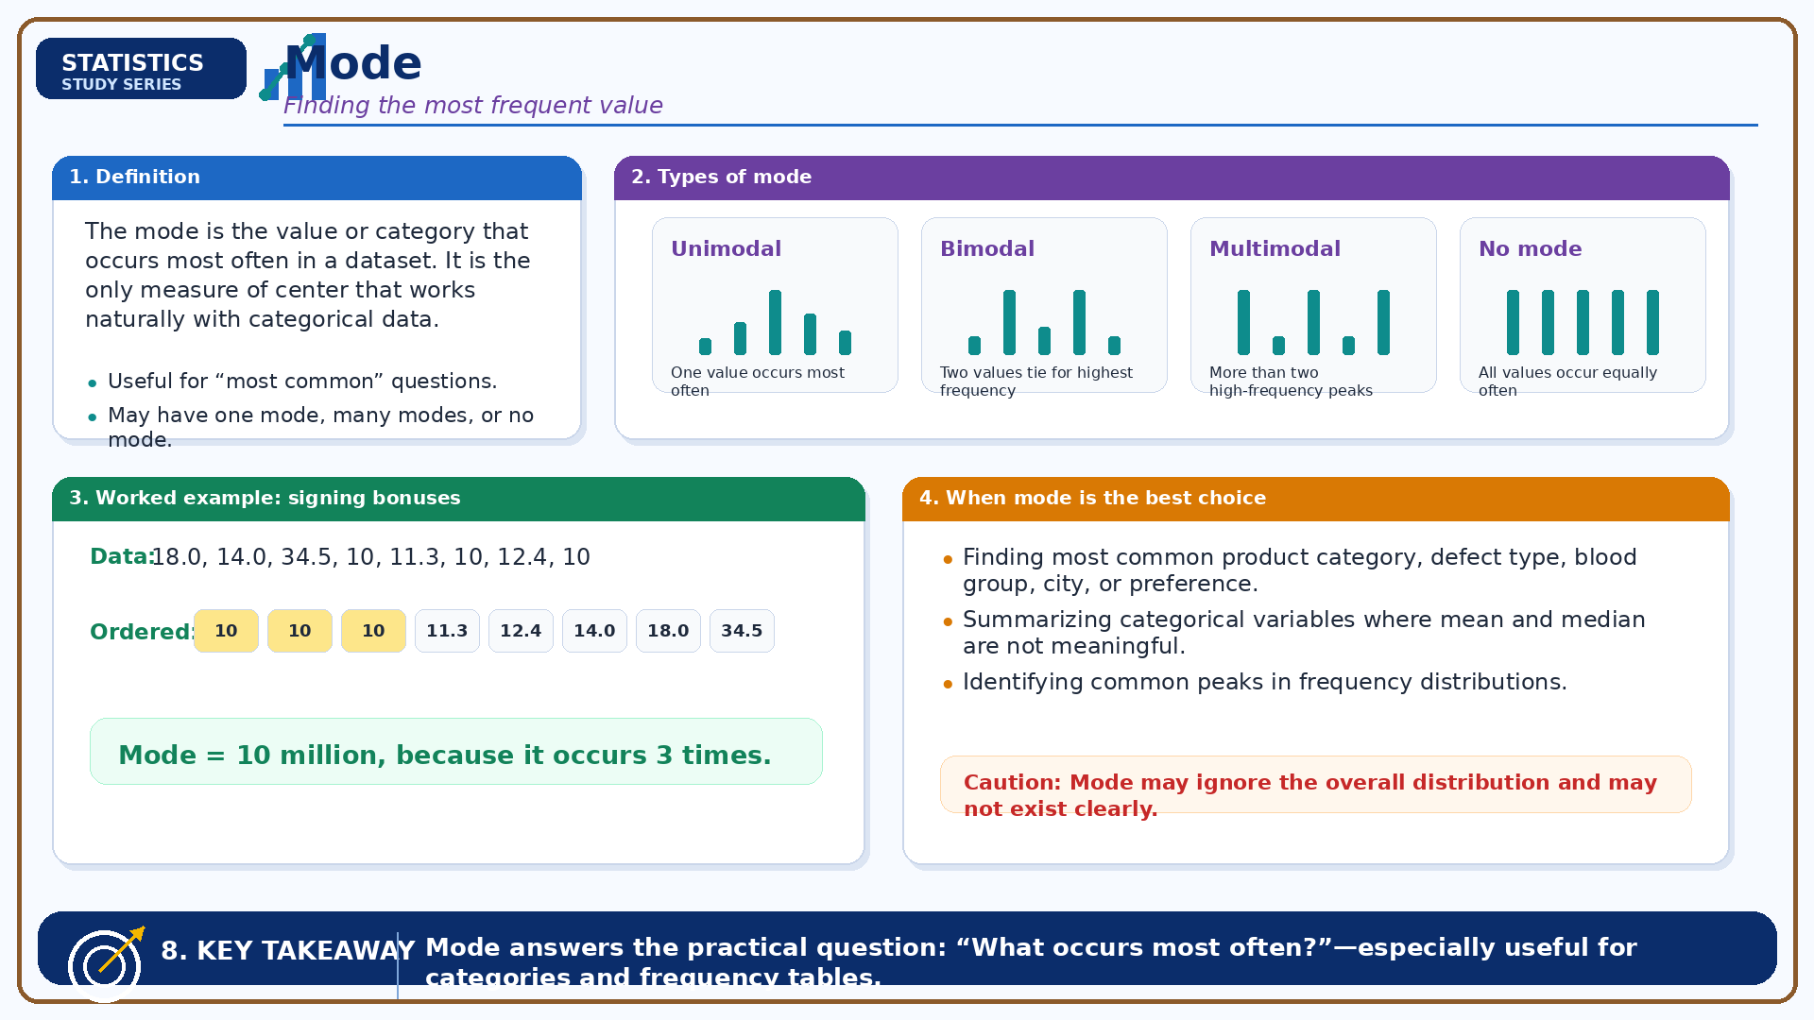
Mode: Finding the Most Frequent Value
Module 2: Measures of Central Tendency
Infographic 8 of 18

Slide 12
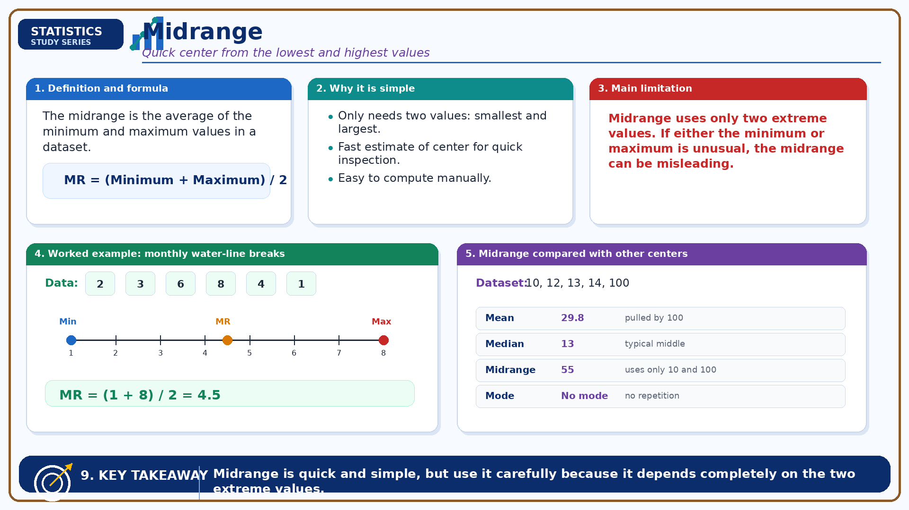
Midrange: Quick Center from Lowest and Highest Values
Module 2: Measures of Central Tendency
Infographic 9 of 18

Slide 13
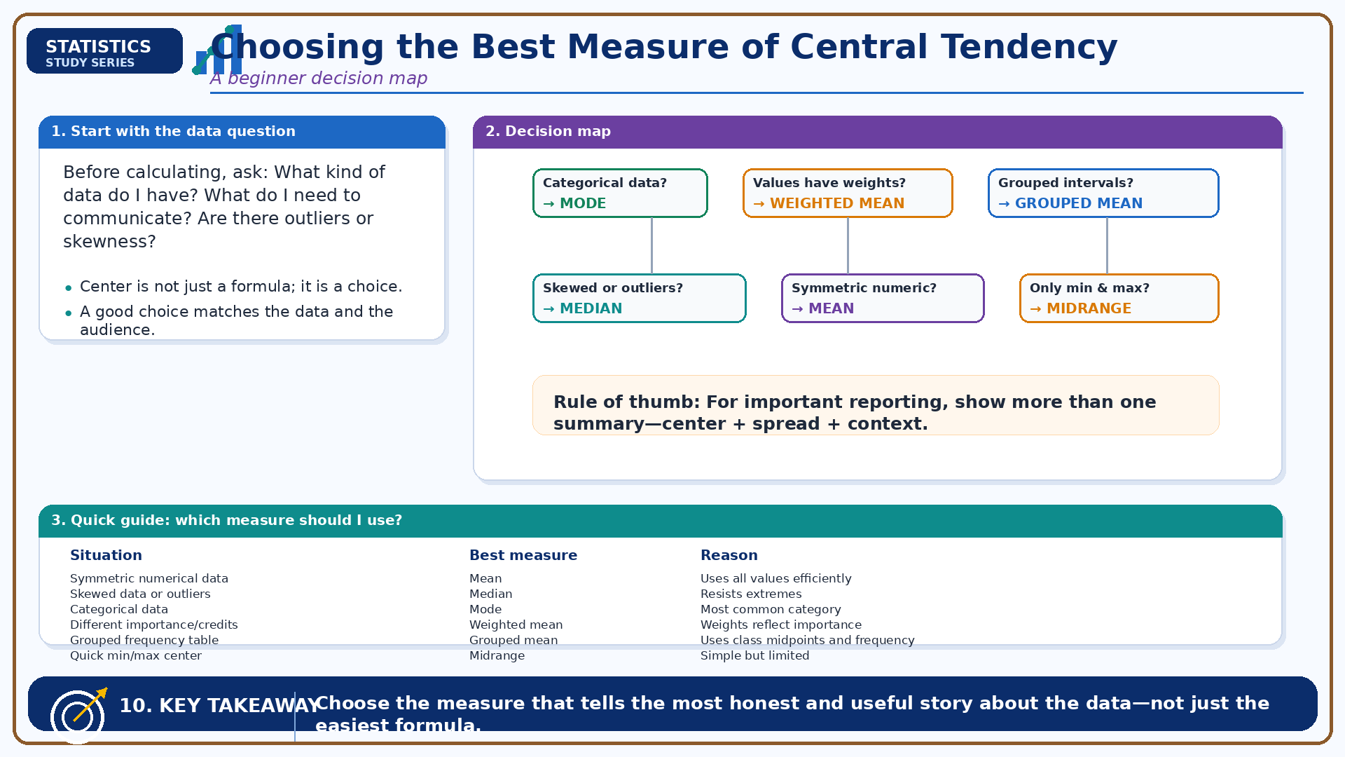
Choosing the Best Measure of Central Tendency
Module 2: Measures of Central Tendency
Infographic 10 of 18

Slide 14
Module 3: Shape of Data
3 infographic slides
Section 3 of 5

Slide 15
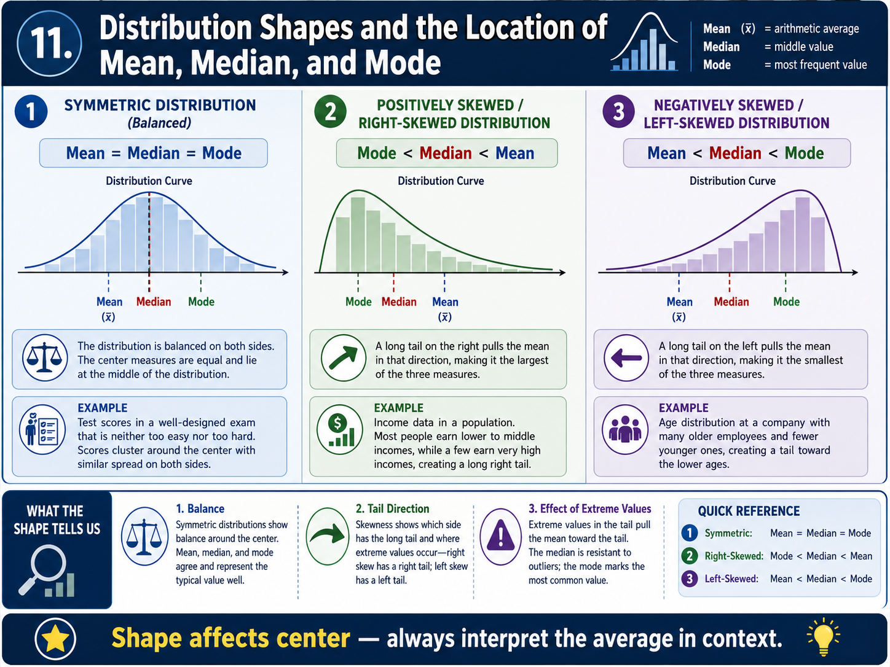
Distribution Shapes and the Location of Mean, Median, and Mode
Module 3: Shape of Data
Infographic 11 of 18

Slide 16
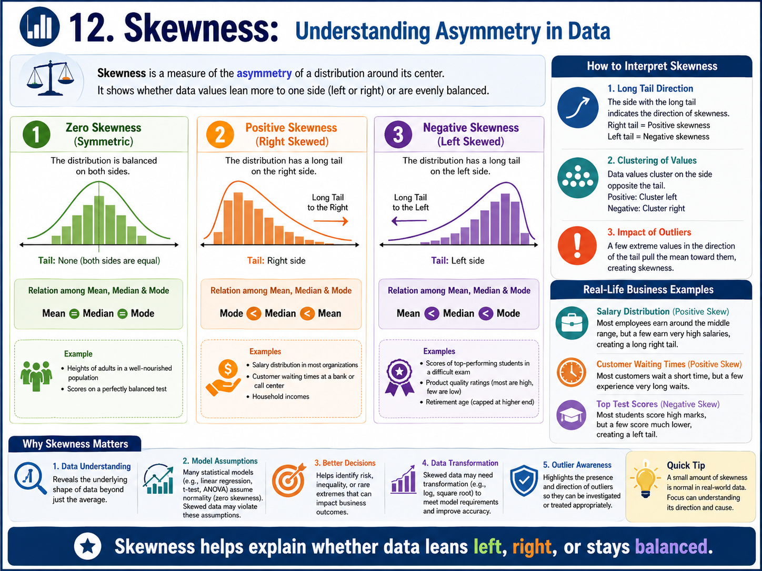
Skewness: Understanding Asymmetry in Data
Module 3: Shape of Data
Infographic 12 of 18

Slide 17
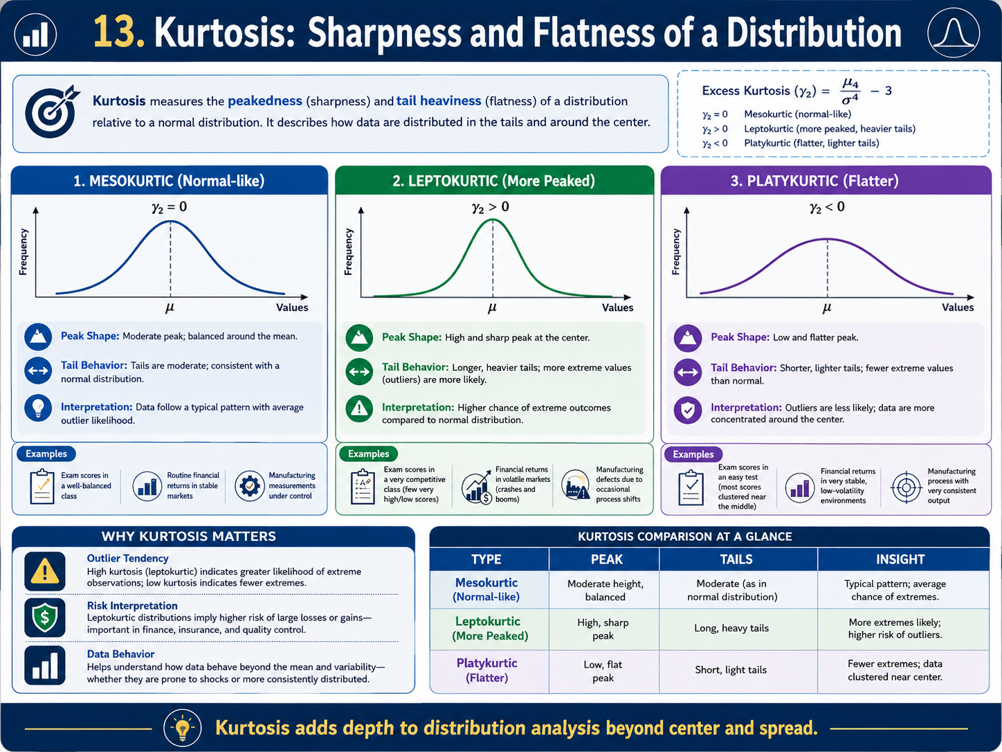
Kurtosis: Sharpness and Flatness of a Distribution
Module 3: Shape of Data
Infographic 13 of 18

Slide 18
Module 4: Measures of Variation
4 infographic slides
Section 4 of 5

Slide 19
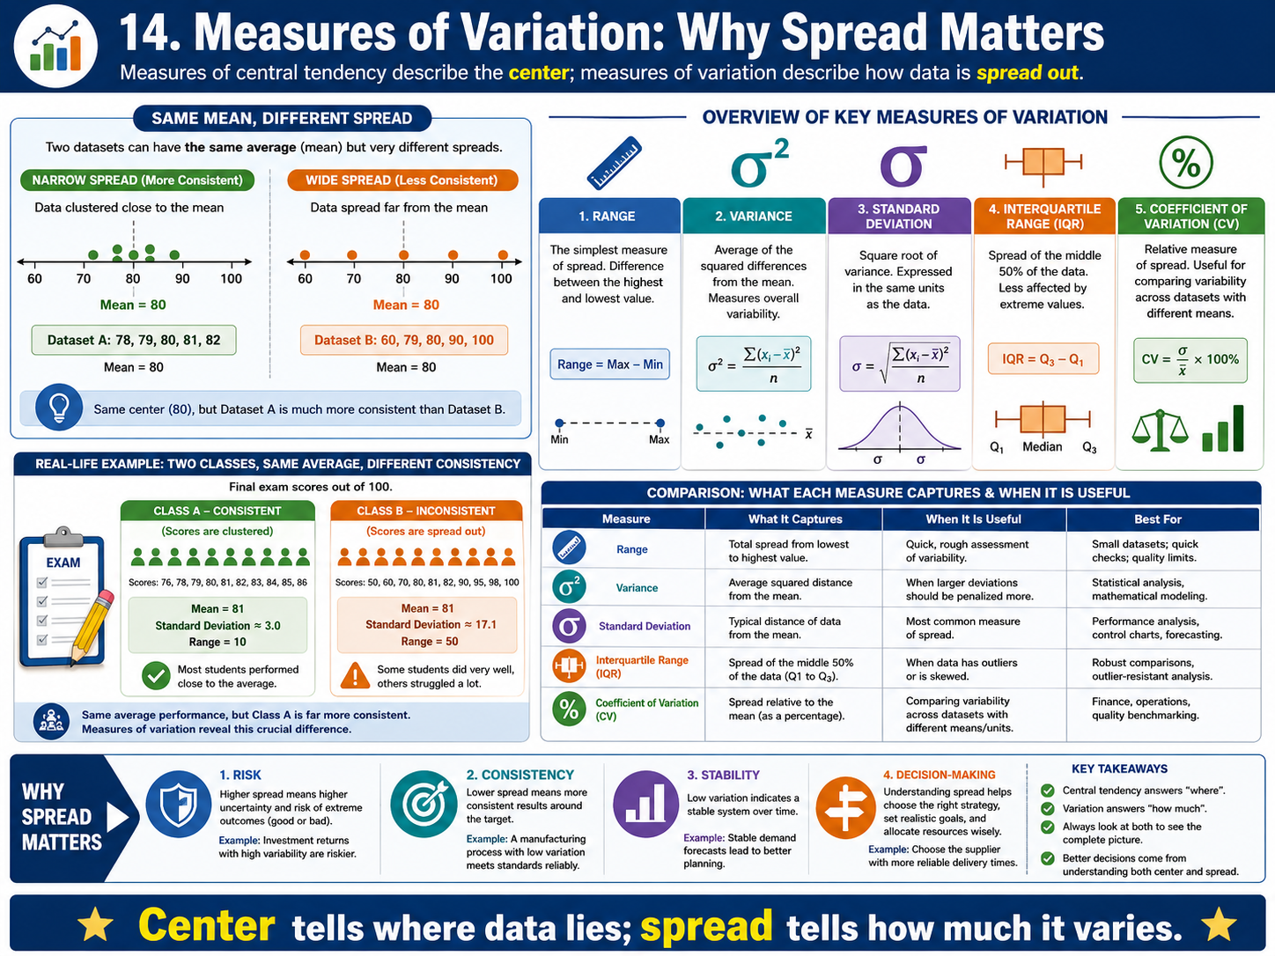
Measures of Variation: Why Spread Matters
Module 4: Measures of Variation
Infographic 14 of 18

Slide 20
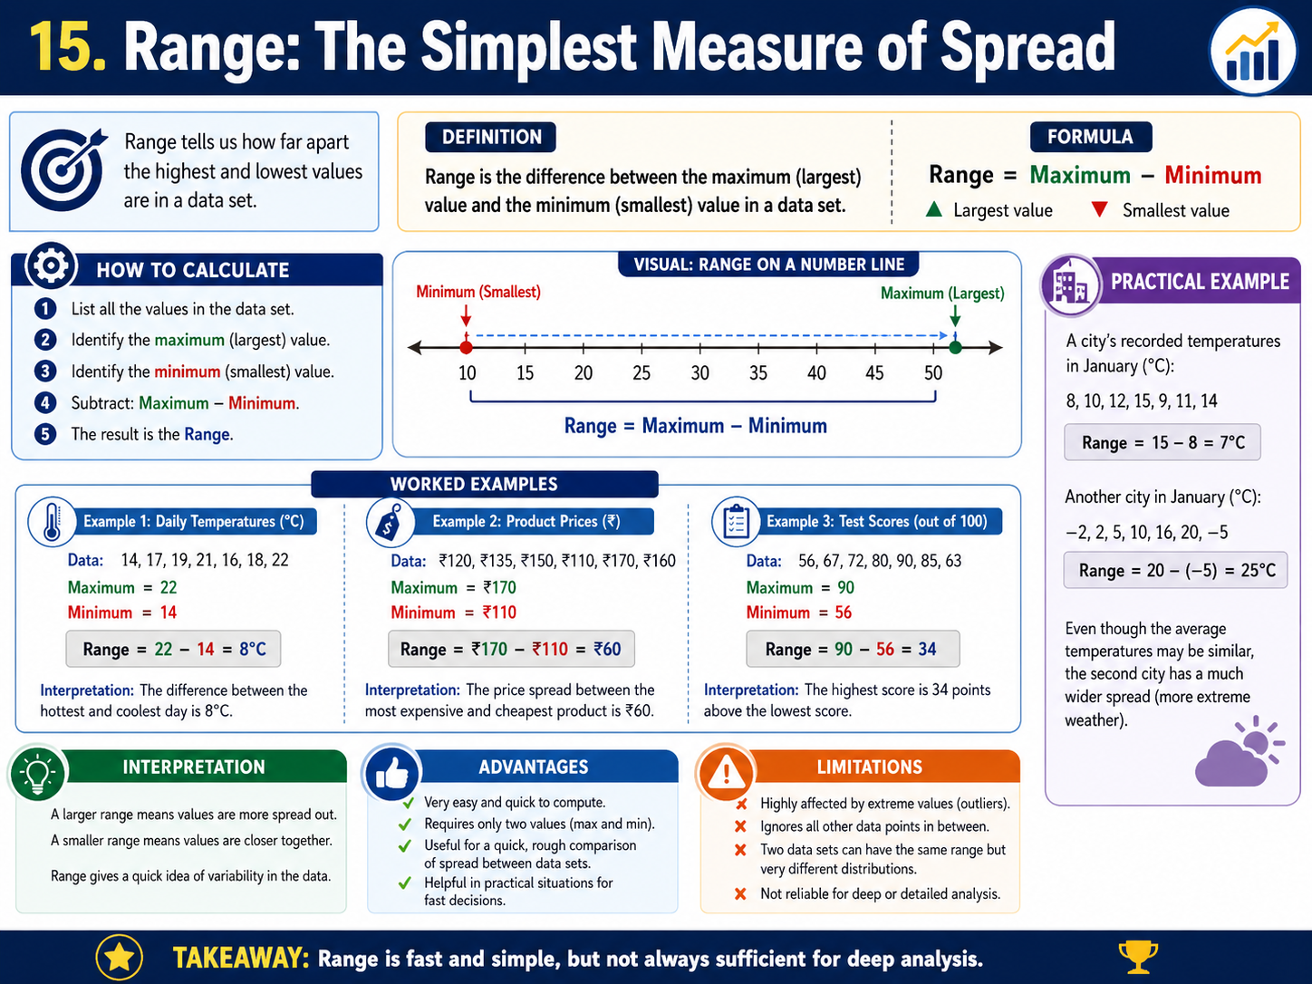
Range: The Simplest Measure of Spread
Module 4: Measures of Variation
Infographic 15 of 18

Slide 21
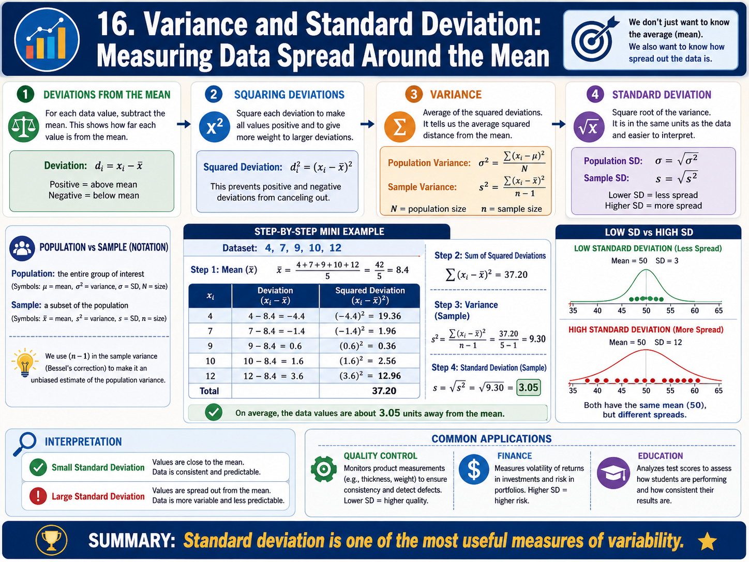
Variance and Standard Deviation: Measuring Data Spread Around the Mean
Module 4: Measures of Variation
Infographic 16 of 18

Slide 22
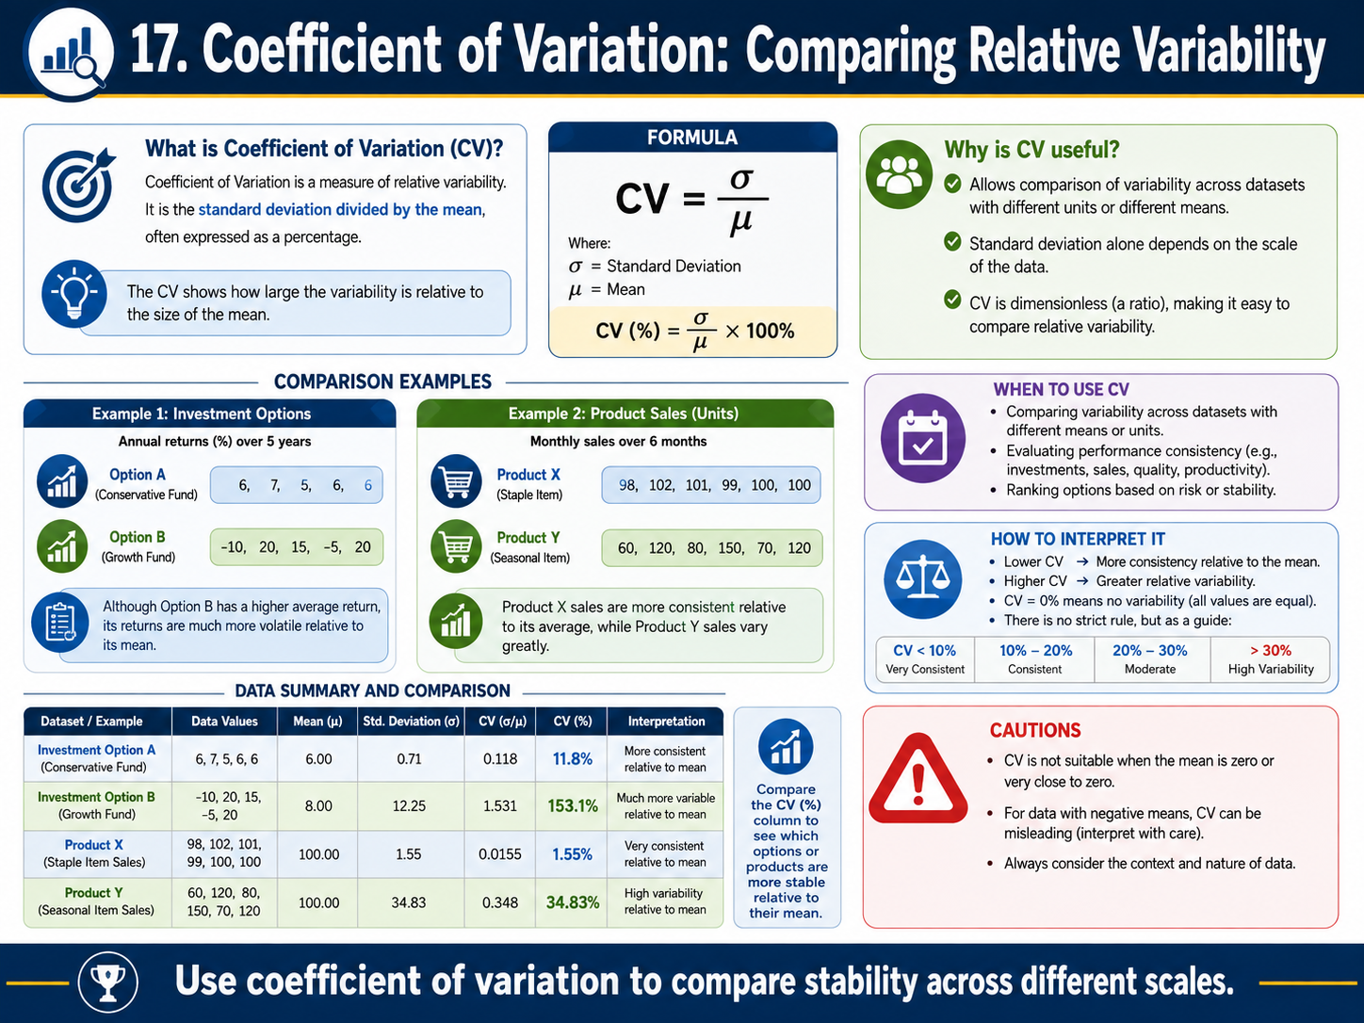
Coefficient of Variation: Comparing Relative Variability
Module 4: Measures of Variation
Infographic 17 of 18

Slide 23
Module 5: Boxplot, Z-Score, and Outliers
1 infographic slide
Section 5 of 5

Slide 24
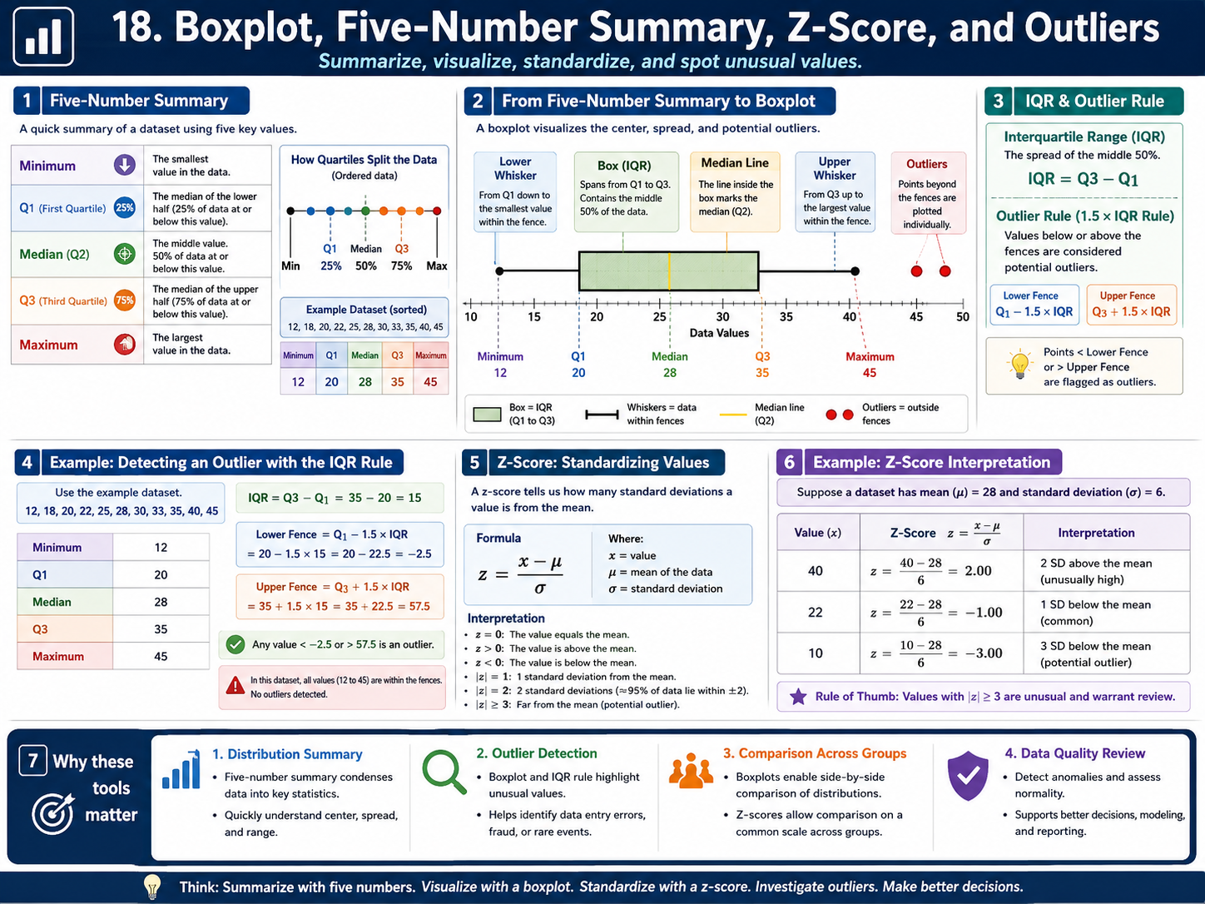
Boxplot, Five-Number Summary, Z-Score, and Outliers
Module 5: Boxplot, Z-Score, and Outliers
Infographic 18 of 18

